Slide 1

From Nand to Tetris
Building a Modern Computer from First Principles
Chapter 2
Boolean Arithmetic
These slides support chapter 2 of the book
The Elements of Computing Systems
(1st and 2nd editions)
By Noam Nisan and Shimon Schocken
MIT Press

Slide 2
Usage Notice
You are welcome to use this presentation, or any part of it, in Nand to Tetris courses, or in other courses, as you see fit.
Usage is free provided that it supports instruction in educational, non-profit settings.
You can use the slides as-is, or modify them as needed.
We’ll appreciate it if you will credit Nand to Tetris somewhere, and put a reference to www.nand2tetris.org
Happy teaching!
Shimon Schocken / Noam Nisan

Slide 3
Nand to Tetris Roadmap: Hardware
abstraction
machine language
assembler
p6
hardware platform
abstraction
Building a computer
computer
abstraction
Building chips
p4
ALU, RAM
abstraction
Building gates
p5
p2
elementary logic gates
Nand
p3
p1

Slide 4
Nand to Tetris Roadmap: Hardware
abstraction
machine language
assembler
p6
hardware platform
abstraction
Building a computer
computer
abstraction
Building chips
p4
ALU, RAM
abstraction
Building gates
p5
p2
elementary logic gates
Nand
p3
p1
Project 1
Build 15 elementary logic gates

Slide 5
Nand to Tetris Roadmap: Hardware
abstraction
machine language
assembler
p6
hardware platform
abstraction
Building a computer
computer
abstraction
Building chips
p4
ALU, RAM
abstraction
Building gates
p5
p2
elementary logic gates
Nand
p3
p1
Project 2
Building chips that do arithmetic, ending up with an ALU

Slide 6
Computer system
Memory
CPU
Input
ALU
Output
Registers

Slide 7
Computer system
Memory
CPU
Input
ALU
Output
Registers

Slide 8
Arithmetic Logical Unit
f
x
f
(x, y)
The ALU computes a given function on two given n-bit values, and outputs an n-bit value
ALU
y
ALU functions (f)
Arithmetic: x + y, x – y, x + 1, x – 1, ...
Logical: x & y, x | y, !x , ...

Slide 9
Arithmetic Logical Unit
+
(40521)
1001111001001001
(40538)
1001111001011010
The ALU computes a given function on two given n-bit values, and outputs an n-bit value
(17)
ALU
0000000000010001
ALU functions (f)
Arithmetic: x + y, x – y, x + 1, x – 1, ...
Logical: x & y, x | y, !x , ...
Challenges
Use 0’s and 1’s for representing numbers
Use logic gates for realizing arithmetic functions.

Slide 10
Chapter 2: Boolean Arithmetic
Theory
Representing numbers
Binary numbers
Boolean arithmetic
Signed numbers
Practice
Arithmetic Logic Unit (ALU)
Project 2: Chips
Project 2: Guidelines

Slide 11
Chapter 2: Boolean Arithmetic
Theory
Representing numbers
Binary numbers
Boolean arithmetic
Signed numbers
Practice
Arithmetic Logic Unit (ALU)
Project 2: Chips
Project 2: Guidelines

Slide 12
Representation
This is not a pipe
(by René Magritte)

Slide 13
Representation
17
This is not seventeen.
Rather, it’s an agreed-upon code (numeral)
that represents the number seventeen.

Slide 14
A brief history of numeral systems
Twenty seven goats
Unary:
Egyptian:
Roman:
XXVII

Slide 15
A brief history of numeral systems
Six thousands, five hundreds, and seven goats
. . .
Unary:
. . .
Egyptian:
Old numeral systems:
Don’t scale
Cumbersome arithmetic
Used until about 1000 years ago
Blocked the progress of Algebra (and commerce, science, technology)
Roman:
MMMMMMDVII

Slide 16
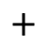
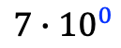
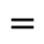
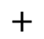
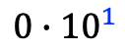
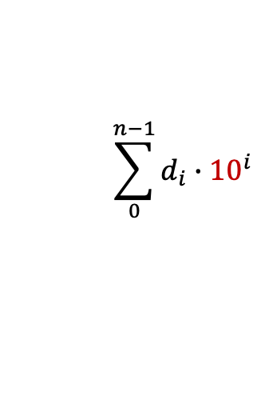
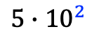
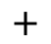
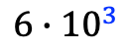
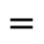
Positional numeral system
Six thousands, five hundreds, and seven goats
. . .
3
2
1
0
6 5 0 7
$$\sum_{0}^{n−1}{d_{i}}∙{10}^{i}$$
$$=$$
$$6∙{10}^{3}$$
$$+$$
$$5∙{10}^{2}$$
$$+$$
$$0∙{10}^{1}$$
$$+$$
$$7∙{10}^{0}$$
$$=$$
6507
A most important innovation, brought to the West from the East around 1200
Where n is the number of digits in the numeral, and d_{i} is the digit in position i
Positional representation
Digits: A fixed set of symbols, including 0
Base: The number of symbols
Numeral: An ordered sequence of digits
Value: The digit in position i (counting from right to left, and starting at 0) encodes how many copies of base^{i} are added to the value.
The method mentions no specific base.

Slide 17

Chapter 2: Boolean Arithmetic
Theory
Representing numbers
Binary numbers
Boolean arithmetic
Representing signed numbers
Practice
Arithmetic Logic Unit (ALU)
Project 2: Chips
Project 2: Guidelines

Slide 18

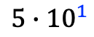

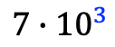
Positional number system
Seven thousands and fifty three goats
. . .
3
2
1
0
7 0 5 3₁₀
$$\sum_{0}^{n−1}{d_{i}}∙{10}^{i}$$
$$=$$
$$7∙{10}^{3}$$
$$+$$
$$0∙{10}^{2}$$
$$+$$
$$5∙{10}^{1}$$
$$+$$
$$3∙{10}^{0}$$
$$=$$
7053

Slide 19
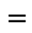
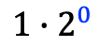
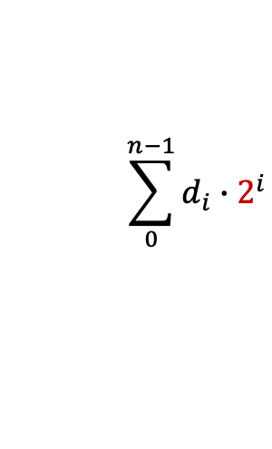

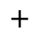
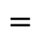
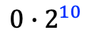
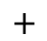
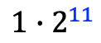
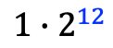
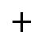
Positional number system
Seven thousands and fifty three goats
. . .
Decimal (base 10) system:
Human friendly
3
2
1
0
7 0 5 3₁₀
$$\sum_{0}^{n−1}{d_{i}}∙{10}^{i}$$
$$=$$
$$7∙{10}^{3}$$
$$+$$
$$0∙{10}^{2}$$
$$+$$
$$5∙{10}^{1}$$
$$+$$
$$3∙{10}^{0}$$
$$=$$
7053
12
11
10
. . .
3
2
1
0
Binary (base 2) system:
Computer friendly
1 1 0 1 1 1 0 0 0 1 1 0 1₂
. . .
$$\sum_{0}^{n−1}{d_{i}}∙2^{i}$$
$$=$$
$$1∙2^{12}$$
$$+$$
$$1∙2^{11}$$
$$+$$
$$0∙2^{10}$$
$$+$$
$$…$$
$$+$$
$$1∙2^{0}$$
$$=$$
7053

Slide 20
Binary and decimal systems
Binary
Decimal
0
1
1 0
1 1
1 0 0
1 0 1
1 1 0
1 1 1
1 0 0 0
1 0 0 1
1 0 1 0
1 0 1 1
1 1 0 0
1 1 0 1
...
0
1
2
3
4
5
6
7
8
9
10
11
12
13
...
Humans are used to enter and view numbers in base 10;
Computers represent and process numbers in base 2;
Therefore, we need efficient algorithms for converting from one base to the other.

Slide 21
Decimal binary conversions

Slide 22
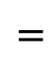
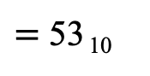
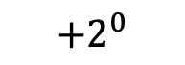
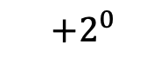
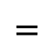
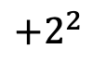
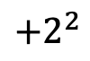
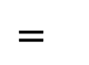
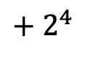

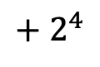
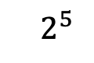
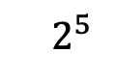

Decimal binary conversions
Powers of 2: (aids in calculations)
2⁰ = 1
2¹ = 2
2² = 4
2³ = 8
2⁴ = 16
2⁵ = 32
2⁶ = 64
2⁷ = 128
2⁸ = 256
2⁹ = 512
2¹⁰ = 1024
. . .
Binary to decimal:
543210
$$+2^{2}$$
$${ 2}^{5}$$
$$+ 2^{4}$$
$$+2^{0}$$
$=$ 53₁₀
$$=$$
(
decimal (
110101₂
Decimal to binary:
543210
binary (
53₁₀) =
$$+2^{2}$$
$${ 2}^{5}$$
$$+ 2^{4}$$
$$+2^{0}$$
110101₂
$$=$$
Algorithm: What is the largest power of 2 that “fits into” 53? It’s 32 = 2⁵. We still have to handle 53 – 32, so, what is the largest power of 2 that fits into 21? It’s 16 = 2⁴, and so on.
Practice:
(
$$?$$
$$=$$
decimal (
1011010₂
$$=$$
$$?$$
(
binary (
523₁₀

Slide 23
Decimal binary conversions
Powers of 2: (aids in calculations)
2⁰ = 1
2¹ = 2
2² = 4
2³ = 8
2⁴ = 16
2⁵ = 32
2⁶ = 64
2⁷ = 128
2⁸ = 256
2⁹ = 512
2¹⁰ = 1024
. . .
Binary to decimal:
543210
$$+2^{2}$$
$${ 2}^{5}$$
$$+ 2^{4}$$
$$+2^{0}$$
$=$ 53₁₀
$$=$$
(
decimal (
110101₂
Decimal to binary:
543210
binary (
53₁₀) =
$$+2^{2}$$
$${ 2}^{5}$$
$$+ 2^{4}$$
$$+2^{0}$$
110101₂
$$=$$
Algorithm: What is the largest power of 2 that “fits into” 53? It’s 32 = 2⁵. We still have to handle 53 – 32, so, what is the largest power of 2 that fits into 21? It’s 16 = 2⁴, and so on.
Practice:
(
$$=$$
decimal (
90₁₀
1011010₂
$$=$$
(
binary (
523₁₀
1000001011₂

Slide 24
The binary system
Inside computers, everything is binary
G.W. Leibnitz (1646 – 1716)
Worshipped binary numbers
Binary numerals are easy to:
Compare
Add
Subtract
Multiply
Divide
...
Store
Transmit
Verify
Correct
Compress
...

Slide 25
Chapter 2: Boolean Arithmetic
Theory
Representing numbers
Binary numbers
Boolean arithmetic
Signed numbers
Practice
Arithmetic Logic Unit (ALU)
Project 2: Chips
Project 2: Guidelines

Slide 26
Boolean arithmetic
We have to figure out efficient ways to perform, on binary numbers:
Addition
Subtraction
Multiplication
Division
We’ll implement it using logic gates
We’ll get it for free
Based on addition
Addition is the foundation of all arithmetic operations.

Slide 27
Addition
0
0
1
0
0
1
1
0
1
0
1
0
7
8
7
5
+
+
1
1
5
6
2
1
1
0
1
8
4
3
7
Binary addition
Decimal addition

Slide 28
Addition
0
0
1
0
1
0
1
0
+
1
1
1
1
0
1
Binary addition

Slide 29
Addition
Computers represent integers using a fixed number of bits, sometimes called “word size”. For example, let’s assume n = 4:
0
0
1
0
1
0
1
0
0
0
0
1
+
+
0
0
1
1
0
1
0
1
1
1
0
1
Binary addition
Another example

Slide 30
Addition
Computers represent integers using a fixed number of bits, sometimes called “word size”. For example, let’s assume n = 4:
0
0
1
0
0
0
1
1
0
1
0
0
0
0
1
+
+
0
0
1
1
0
1
0
1
1
1
0
1
0
1
1
0
Binary addition
Another example

Slide 31
Addition
Computers represent integers using a fixed number of bits, sometimes called “word size”. For example, let’s assume n = 4:
0
0
1
0
0
0
1
1
0
1
0
0
0
0
1
0
1
1
1
+
+
+
0
0
1
1
0
1
0
1
1
1
1
0
1
1
0
1
0
1
1
0
Binary addition
Another example
Another example

Slide 32
Addition
Computers represent integers using a fixed number of bits, sometimes called “word size”. For example, let’s assume n = 4:
0
0
1
0
0
0
1
1
1
1
0
1
0
1
0
0
0
0
1
0
1
1
1
+
+
+
0
0
1
1
0
1
0
1
1
1
1
0
1
1
0
1
0
1
1
0
1
0
1
0
1
Binary addition
Another example
Overflow
Handling overflow
Our decision: Ignore it
As we will soon see, ignoring the overflow bit is not a bug, it’s a feature.

Slide 33
Addition
Word size n = 16, 32, 64, …
0
...
0
0
0
0
0
1
1
0
1
1
1
0
0
0
Same addition algorithm for any n
0
...
0
0
0
0
0
0
1
1
0
1
0
1
0
1
+
0
...
0
0
0
0
0
0
0
1
0
1
1
1
0
0
0
...
0
0
0
0
0
1
0
0
1
1
0
0
0
1
Hardware implementation
We’ll build an Adder chip that implements this addition algorithm,
Using the chips built in project 1.
How? Later.
Teaching Note
In Nand to Tetris we always separate abstraction from implementation
First we present the abstraction, leaving the implementation to a later stage in the lecture.

Slide 34
Chapter 2: Boolean Arithmetic
Theory
Representing numbers
Binary numbers
Boolean arithmetic (addition)
Signed numbers
Practice
Arithmetic Logic Unit (ALU)
Project 2: Chips
Project 2: Guidelines

Slide 35
Chapter 2: Boolean Arithmetic
Theory
Representing numbers
Binary numbers
Boolean arithmetic (addition)
Signed numbers
Practice
Arithmetic Logic Unit (ALU)
Project 2: Chips
Project 2: Guidelines
(x + y, –x + y, x + –y, –x + –y)

Slide 36
Signed integers
Teaching Note
Designers of low-level hardware / software systems use numerous ingenious hacks for optimizing arithmetic operations, memory manipulations, graphics, signal processing, and other mission critical computer operations.
The Two’s Complement method is a simple and powerful example of this art.
Instead of building different chips for handling, say, addition and subtraction, we choose to represent signed numbers cleverly. The representation allows us to use the same Adder chips for doing addition, subtraction, and mixed sign arithmetic.
The result – often taken for granted – is one of the most dramatic optimizations in computer processing.
This triumph of human reasoning over physical work is therefore worth teaching and celebrating.

Slide 37
Signed integers
Positive
0
Negative
In most programming languages, the short, int, and long data types use 16, 32, and 64 bits for representing signed integers
Arithmetic operations on signed integers (x op y, –x op y, x op –y, –x op –y, where op = {+, –, *, /}) are by far what computers do most of the time
Therefore …
Efficient algorithms for handling arithmetic operations on signed integers hold the key to building efficient computers.
Teaching Note: All the algorithms presented in this course can be implemented efficiently in either hardware of software.

Slide 38
Signed integers
code(x)
x
This particular example: word size is n = 4
In general, n bits allow representing all the unsigned integers 0 … 2^{n} – 1
0000 0 0
0001 1 1
0010 2 2
0011 3 3
0100 4 4
0101 5 5
0110 6 6
0111 7 7
1000 8 8
1001 9 9
1010 10 10
1011 11 11
1100 12 12
1101 13 13
1110 14 14
1111 15 15
What about negative numbers?
We can use half of the code space for representing positive numbers, and the other half for negatives.

Slide 39
Signed integers
code(x)
x
0000 0 0
0001 1 1
0010 2 2
0011 3 3
0100 4 4
0101 5 5
0110 6 6
0111 7 7
1000 8 – 0
1001 9 – 1
1010 10 – 2
1011 11 – 3
1100 12 – 4
1101 13 – 5
1110 14 – 6
1111 15 – 7
Representation:
Left-most bit (MSB): Represents the sign, +/-
Remaining bits: Represent a positive integer
Issues
– 0: Huh?
code(x) + code(– x) ≠ code(0)
The codes are not monotonically increasing
more complications.

Slide 40
Two’s complement
code(x)
x
The representation
Assumption: Word size = n bits
The “two’s complement” of x is defined to be 2^{n} – x
The negative of x is coded by the two’s complement of x
0000 0 0
0001 1 1
0010 2 2
0011 3 3
0100 4 4
0101 5 5
0110 6 6
0111 7 7
1000 8 – 8
1001 9 – 7
1010 10 – 6
1011 11 – 5
1100 12 – 4
1101 13 – 3
1110 14 – 2
1111 15 – 1
From decimal to binary:
if x ≥ 0 return binary(x)
else return binary(2^{n} – x)
From binary to decimal:
if MSB = 0 return decimal(bits)
else return “–” and then (2^{n} – decimal(bits))

Slide 41
Two’s complement: Addition
code(x)
x
Compute x + y where x and y are signed
0000 0 0
0001 1 1
0010 2 2
0011 3 3
0100 4 4
0101 5 5
0110 6 6
0111 7 7
1000 8 – 8
1001 9 – 7
1010 10 – 6
1011 11 – 5
1100 12 – 4
1101 13 – 3
1110 14 – 2
1111 15 – 1
Algorithm: Regular addition, modulo 2^{n}
6
6
+
=
+
–2
14
20
% 16 = 4
codes 4
3
3
+
=
+
–5
11
14
% 16 = 14
codes –2
–2
14
+
=
+
–5
11
25
% 16 = 9
codes –7

Slide 42


Two’s complement: Addition
code(x)
x
Compute x + y where x and y are signed
0000 0 0
0001 1 1
0010 2 2
0011 3 3
0100 4 4
0101 5 5
0110 6 6
0111 7 7
1000 8 – 8
1001 9 – 7
1010 10 – 6
1011 11 – 5
1100 12 – 4
1101 13 – 3
1110 14 – 2
1111 15 – 1
Algorithm: Regular addition, modulo 2^{n}
6
6
+
=
+
–2
14
20
% 16 = 4
codes 4
Practice:
4
$$?$$
+
=
–7
–2
=
$$?$$
+
–4

Slide 43
Two’s complement: Addition
code(x)
x
Compute x + y where x and y are signed
0000 0 0
0001 1 1
0010 2 2
0011 3 3
0100 4 4
0101 5 5
0110 6 6
0111 7 7
1000 8 – 8
1001 9 – 7
1010 10 – 6
1011 11 – 5
1100 12 – 4
1101 13 – 3
1110 14 – 2
1111 15 – 1
Algorithm: Regular addition, modulo 2^{n}
6
6
+
=
+
–2
14
20
% 16 = 4
codes 4
Practice:
4
4
+
=
+
–7
9
13
% 16 = 13
codes –3
–2
14
+
=
+
–4
12
26
% 16 = 10
codes –6

Slide 44
Two’s complement: Addition
code(x)
x
At the binary level (same algorithm):
0000 0 0
0001 1 1
0010 2 2
0011 3 3
0100 4 4
0101 5 5
0110 6 6
0111 7 7
1000 8 – 8
1001 9 – 7
1010 10 – 6
1011 11 – 5
1100 12 – 4
1101 13 – 3
1110 14 – 2
1111 15 – 1
6
0110
+
=
+
Ignoring the overflow bit is the binary equivalent of modulo 2^{n}
–2
1110
10100
codes 4
3
0011
+
=
+
–5
1011
1110
codes –2
–2
1110
+
=
+
–5
1011
11001
codes –7

Slide 45
Two’s complement: Addition
code(x)
x
At the binary level (same algorithm):
0000 0 0
0001 1 1
0010 2 2
0011 3 3
0100 4 4
0101 5 5
0110 6 6
0111 7 7
1000 8 – 8
1001 9 – 7
1010 10 – 6
1011 11 – 5
1100 12 – 4
1101 13 – 3
1110 14 – 2
1111 15 – 1
6
0110
+
=
+
–2
1110
10100
codes 4
More examples:
5
0101
+
=
+
7
0111
1100
codes –4
5 + 7 = –4 ???
–7
1001
+
=
+
–3
1101
10110
codes 6
–7 + –3 = 6 ???
Overflow detection
When you add up two positives (negatives) and get a negative (positive) result, you know that you have overflow

Slide 46
Two’s complement: Subtraction
code(x)
x
Compute x – y where x and y are signed
0000 0 0
0001 1 1
0010 2 2
0011 3 3
0100 4 4
0101 5 5
0110 6 6
0111 7 7
1000 8 – 8
1001 9 – 7
1010 10 – 6
1011 11 – 5
1100 12 – 4
1101 13 – 3
1110 14 – 2
1111 15 – 1
x – y is the same as x + (–y)
So… convert y and add up the two values (we already know how to add up signed numbers)
But … How to convert a number (efficiently)?

Slide 47
Two’s complement: Sign conversion
code(x)
x
Compute –x from x
0000 0 0
0001 1 1
0010 2 2
0011 3 3
0100 4 4
0101 5 5
0110 6 6
0111 7 7
1000 8 – 8
1001 9 – 7
1010 10 – 6
1011 11 – 5
1100 12 – 4
1101 13 – 3
1110 14 – 2
1111 15 – 1
Insight:
code(–x) = (2^{n} – x)
= 1 + (2^{n} – 1) – x
= 1 + (1111) – x
= 1 + flippedBits(x)
Algorithm: To convert bbb...b:
Flip all the bits and add 1 to the result
Example: Convert 0010 (2)
1101 (flipped)
+
1
1110 (–2)

Slide 48
Two’s complement: Sign conversion
code(x)
x
Compute –x from x
0000 0 0
0001 1 1
0010 2 2
0011 3 3
0100 4 4
0101 5 5
0110 6 6
0111 7 7
1000 8 – 8
1001 9 – 7
1010 10 – 6
1011 11 – 5
1100 12 – 4
1101 13 – 3
1110 14 – 2
1111 15 – 1
Insight:
code(–x) = (2^{n} – x)
= 1 + (2^{n} – 1) – x
= 1 + (1111) – x
= 1 + flippedBits(x)
Algorithm: To convert bbb...b:
Flip all the bits and add 1 to the result
Practice: Convert 1010 (–6)

Slide 49
Two’s complement: Sign conversion
code(x)
x
Compute –x from x
0000 0 0
0001 1 1
0010 2 2
0011 3 3
0100 4 4
0101 5 5
0110 6 6
0111 7 7
1000 8 – 8
1001 9 – 7
1010 10 – 6
1011 11 – 5
1100 12 – 4
1101 13 – 3
1110 14 – 2
1111 15 – 1
Insight:
code(–x) = (2^{n} – x)
= 1 + (2^{n} – 1) – x
= 1 + (1111) – x
= 1 + flippedBits(x)
Algorithm: To convert bbb...b:
Flip all the bits and add 1 to the result
Practice: Convert 1010 (–6)
0101 (flipped)
+
1
0110 (6)

Slide 50
Two’s complement: Recap
code(x)
x
Observations
The method represents all the integers in the range –2^{n–1}, ..., –1, 0, 1, ..., 2^{n–1} – 1
code(x) + code(– x) = code(0)
The codes are monotonically increasing
Arithmetic on signed integers is the same as arithmetic on unsigned integers
Simple! Elegant! Powerful!
0000 0 0
0001 1 1
0010 2 2
0011 3 3
0100 4 4
0101 5 5
0110 6 6
0111 7 7
1000 8 – 8
1001 9 – 7
1010 10 – 6
1011 11 – 5
1100 12 – 4
1101 13 – 3
1110 14 – 2
1111 15 – 1
Implications for hardware designers
Arithmetic on signed integers can be implemented using the same hardware used for handling arithmetic of unsigned integers

Slide 51
Chapter 2: Boolean Arithmetic
Theory
Representing numbers
Binary numbers
Boolean arithmetic
Signed numbers
Practice
Arithmetic Logic Unit (ALU)
Project 2: Chips
Project 2: Guidelines

Slide 52
Chapter 2: Boolean Arithmetic
Theory
Representing numbers
Binary numbers
Boolean arithmetic
Signed numbers
Practice
Arithmetic Logic Unit (ALU)
Project 2: Chips
Project 2: Guidelines

Slide 53
Von Neumann Architecture
Computer System
Memory
CPU
Input
ALU
Output
Registers

Slide 54
The Arithmetic Logical Unit
f
The ALU computes a given function on its two given data inputs, and outputs the result
input1
f
(input1, input2)
f
: one out of a family of pre-defined arithmetic functions (add, subtract, multiply…) and logical functions (And, Or, Xor, …)
ALU
input2
Design issue: Which functions should the ALU perform?
A hardware / software tradeoff: Any function not implemented by the ALU can be implemented later in system software
Hardware implementations: Faster, and more expensive
Software implementations: Slower, less expensive

Slide 55
The Hack ALU
Operates on two 16-bit, two’s complement values

Slide 56
The Hack ALU
Operates on two 16-bit, two’s complement values
Outputs a 16-bit, two’s complement value
out
0
1
-1
x
y
!x
!y
-x
-y
x+1
y+1
x-1
y-1
x+y
x-y
y-x
x&y
x|y

Slide 57
The Hack ALU
Operates on two 16-bit, two’s complement values
Outputs a 16-bit, two’s complement value
Also outputs two 1-bit values (later)
out
0
1
-1
x
y
!x
!y
-x
-y
x+1
y+1
x-1
y-1
x+y
x-y
y-x
x&y
x|y

Slide 58
The Hack ALU
Operates on two 16-bit, two’s complement values
Outputs a 16-bit, two’s complement value
Also outputs two 1-bit values (later)
Which function to compute is set by six 1-bit inputs
out
0
1
-1
x
y
!x
!y
-x
-y
x+1
y+1
x-1
y-1
x+y
x-y
y-x
x&y
x|y

Slide 59
The Hack ALU
To cause the ALU to compute a function:
Set the control bits to one of the binary combinations listed in the table.
control bits
zx | nx | zy | ny | f | no | out
1 | 0 | 1 | 0 | 1 | 0 | 0
1 | 1 | 1 | 1 | 1 | 1 | 1
1 | 1 | 1 | 0 | 1 | 0 | -1
0 | 0 | 1 | 1 | 0 | 0 | x
1 | 1 | 0 | 0 | 0 | 0 | y
0 | 0 | 1 | 1 | 0 | 1 | !x
1 | 1 | 0 | 0 | 0 | 1 | !y
0 | 0 | 1 | 1 | 1 | 1 | -x
1 | 1 | 0 | 0 | 1 | 1 | -y
0 | 1 | 1 | 1 | 1 | 1 | x+1
1 | 1 | 0 | 1 | 1 | 1 | y+1
0 | 0 | 1 | 1 | 1 | 0 | x-1
1 | 1 | 0 | 0 | 1 | 0 | y-1
0 | 0 | 0 | 0 | 1 | 0 | x+y
0 | 1 | 0 | 0 | 1 | 1 | x-y
0 | 0 | 0 | 1 | 1 | 1 | y-x
0 | 0 | 0 | 0 | 0 | 0 | x&y
0 | 1 | 0 | 1 | 0 | 1 | x|y

Slide 60
The Hack ALU in action
To cause the ALU to compute a function:
Set the control bits to one of the binary combinations listed in the table.
control bits
zx | nx | zy | ny | f | no | out
1 | 0 | 1 | 0 | 1 | 0 | 0
1 | 1 | 1 | 1 | 1 | 1 | 1
1 | 1 | 1 | 0 | 1 | 0 | -1
0 | 0 | 1 | 1 | 0 | 0 | x
1 | 1 | 0 | 0 | 0 | 0 | y
0 | 0 | 1 | 1 | 0 | 1 | !x
1 | 1 | 0 | 0 | 0 | 1 | !y
0 | 0 | 1 | 1 | 1 | 1 | -x
1 | 1 | 0 | 0 | 1 | 1 | -y
0 | 1 | 1 | 1 | 1 | 1 | x+1
1 | 1 | 0 | 1 | 1 | 1 | y+1
0 | 0 | 1 | 1 | 1 | 0 | x-1
1 | 1 | 0 | 0 | 1 | 0 | y-1
0 | 0 | 0 | 0 | 1 | 0 | x+y
0 | 1 | 0 | 0 | 1 | 1 | x-y
0 | 0 | 0 | 1 | 1 | 1 | y-x
0 | 0 | 0 | 0 | 0 | 0 | x&y
0 | 1 | 0 | 1 | 0 | 1 | x|y

Slide 61
The Hack ALU in action: Compute y-x
To cause the ALU to compute a function:
Set the control bits to one of the binary combinations listed in the table.
control bits
zx | nx | zy | ny | f | no | out
1 | 0 | 1 | 0 | 1 | 0 | 0
1 | 1 | 1 | 1 | 1 | 1 | 1
1 | 1 | 1 | 0 | 1 | 0 | -1
0 | 0 | 1 | 1 | 0 | 0 | x
1 | 1 | 0 | 0 | 0 | 0 | y
0 | 0 | 1 | 1 | 0 | 1 | !x
1 | 1 | 0 | 0 | 0 | 1 | !y
0 | 0 | 1 | 1 | 1 | 1 | -x
1 | 1 | 0 | 0 | 1 | 1 | -y
0 | 1 | 1 | 1 | 1 | 1 | x+1
1 | 1 | 0 | 1 | 1 | 1 | y+1
0 | 0 | 1 | 1 | 1 | 0 | x-1
1 | 1 | 0 | 0 | 1 | 0 | y-1
0 | 0 | 0 | 0 | 1 | 0 | x+y
0 | 1 | 0 | 0 | 1 | 1 | x-y
0 | 0 | 0 | 1 | 1 | 1 | y-x
0 | 0 | 0 | 0 | 0 | 0 | x&y
0 | 1 | 0 | 1 | 0 | 1 | x|y

Slide 62
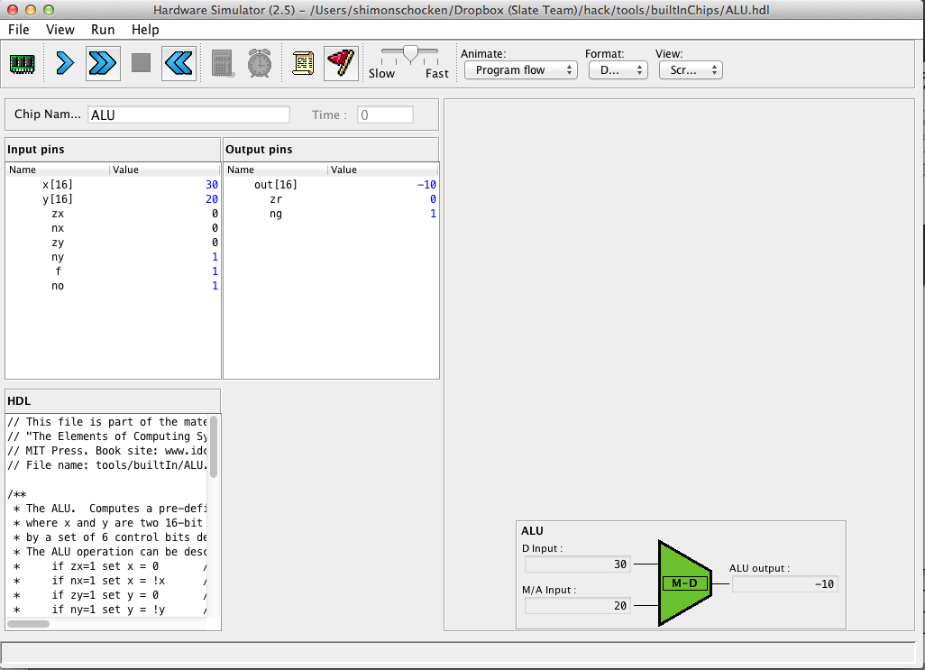
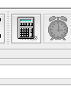
The Hack ALU in action: Compute y-x
2. Evaluate the chip logic
Load
tools/builtInChips/ALU.hdl
3. Inspect the ALU outputs
Set the ALU’s inputs and control bits to some test values
(000111 codes “output y-x”)
The built-in ALU implementation has GUI side-effects
Built-in ALU implementation

Slide 63
The Hack ALU in action
To cause the ALU to compute a function:
Set the control bits to one of the binary combinations listed in the table.
control bits
zx | nx | zy | ny | f | no | out
1 | 0 | 1 | 0 | 1 | 0 | 0
1 | 1 | 1 | 1 | 1 | 1 | 1
1 | 1 | 1 | 0 | 1 | 0 | -1
0 | 0 | 1 | 1 | 0 | 0 | x
1 | 1 | 0 | 0 | 0 | 0 | y
0 | 0 | 1 | 1 | 0 | 1 | !x
1 | 1 | 0 | 0 | 0 | 1 | !y
0 | 0 | 1 | 1 | 1 | 1 | -x
1 | 1 | 0 | 0 | 1 | 1 | -y
0 | 1 | 1 | 1 | 1 | 1 | x+1
1 | 1 | 0 | 1 | 1 | 1 | y+1
0 | 0 | 1 | 1 | 1 | 0 | x-1
1 | 1 | 0 | 0 | 1 | 0 | y-1
0 | 0 | 0 | 0 | 1 | 0 | x+y
0 | 1 | 0 | 0 | 1 | 1 | x-y
0 | 0 | 0 | 1 | 1 | 1 | y-x
0 | 0 | 0 | 0 | 0 | 0 | x&y
0 | 1 | 0 | 1 | 0 | 1 | x|y

Slide 64
The Hack ALU in action: Compute x & y
To cause the ALU to compute a function:
Set the control bits to one of the binary combinations listed in the table.
control bits
zx | nx | zy | ny | f | no | out
1 | 0 | 1 | 0 | 1 | 0 | 0
1 | 1 | 1 | 1 | 1 | 1 | 1
1 | 1 | 1 | 0 | 1 | 0 | -1
0 | 0 | 1 | 1 | 0 | 0 | x
1 | 1 | 0 | 0 | 0 | 0 | y
0 | 0 | 1 | 1 | 0 | 1 | !x
1 | 1 | 0 | 0 | 0 | 1 | !y
0 | 0 | 1 | 1 | 1 | 1 | -x
1 | 1 | 0 | 0 | 1 | 1 | -y
0 | 1 | 1 | 1 | 1 | 1 | x+1
1 | 1 | 0 | 1 | 1 | 1 | y+1
0 | 0 | 1 | 1 | 1 | 0 | x-1
1 | 1 | 0 | 0 | 1 | 0 | y-1
0 | 0 | 0 | 0 | 1 | 0 | x+y
0 | 1 | 0 | 0 | 1 | 1 | x-y
0 | 0 | 0 | 1 | 1 | 1 | y-x
0 | 0 | 0 | 0 | 0 | 0 | x&y
0 | 1 | 0 | 1 | 0 | 1 | x|y

Slide 65
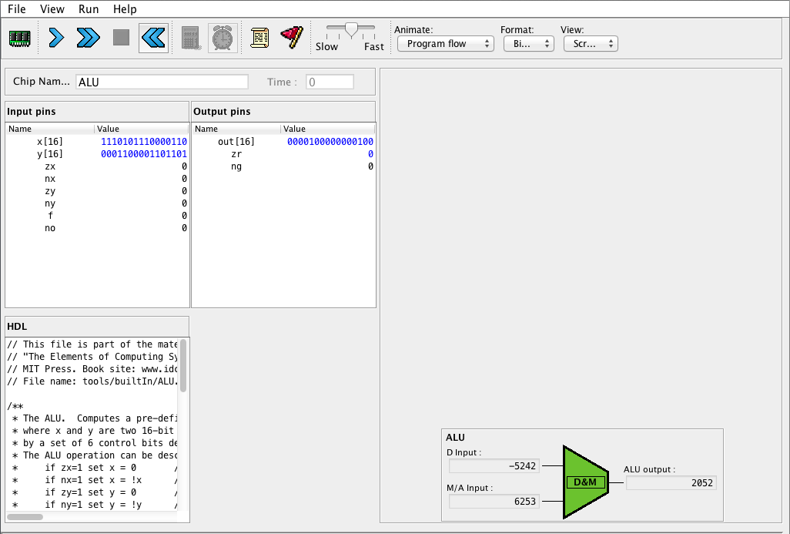
The Hack ALU in action: Compute x & y
Set to binary I/O format
Inspect the ALU outputs
Set the ALU’s inputs and control bits to some test values
(000000 codes “compute x&y”)

Slide 66
The Hack ALU operation

Slide 67
The Hack ALU operation
pre-setting the x input |  | pre-setting the y input |  | selecting between computing + or & | post-setting the output | Resulting ALU output
zx | nx | zy | ny | f | no | out
if zx then x=0 | if nx then x=!x | if zy then y=0 | if ny then y=!y | if f then out=x+y else out=x&y | if no then out=!out | out(x,y)=

Slide 68
The Hack ALU operation
pre-setting the x input |  | pre-setting the y input |  | selecting between computing + or & | post-setting the output | Resulting ALU output
zx | nx | zy | ny | f | no | out
if zx then x=0 | if nx then x=!x | if zy then y=0 | if ny then y=!y | if f then out=x+y else out=x&y | if no then out=!out | out(x,y)=

Slide 69
The Hack ALU operation
pre-setting the x input |  | pre-setting the y input |  | selecting between computing + or & | post-setting the output | Resulting ALU output
zx | nx | zy | ny | f | no | out
if zx then x=0 | if nx then x=!x | if zy then y=0 | if ny then y=!y | if f then out=x+y else out=x&y | if no then out=!out | out(x,y)=

Slide 70
The Hack ALU operation
pre-setting the x input |  | pre-setting the y input |  | selecting between computing + or & | post-setting the output | Resulting ALU output
zx | nx | zy | ny | f | no | out
if zx then x=0 | if nx then x=!x | if zy then y=0 | if ny then y=!y | if f then out=x+y else out=x&y | if no then out=!out | out(x,y)=

Slide 71
The Hack ALU operation
pre-setting the x input |  | pre-setting the y input |  | selecting between computing + or & | post-setting the output | Resulting ALU output
zx | nx | zy | ny | f | no | out
if zx then x=0 | if nx then x=!x | if zy then y=0 | if ny then y=!y | if f then out=x+y else out=x&y | if no then out=!out | out(x,y)=

Slide 72
The Hack ALU operation
pre-setting the x input |  | pre-setting the y input |  | selecting between computing + or & | post-setting the output | Resulting ALU output
zx | nx | zy | ny | f | no | out
if zx then x=0 | if nx then x=!x | if zy then y=0 | if ny then y=!y | if f then out=x+y else out=x&y | if no then out=!out | out(x,y)=
1 | 0 | 1 | 0 | 1 | 0 | 0
1 | 1 | 1 | 1 | 1 | 1 | 1
1 | 1 | 1 | 0 | 1 | 0 | -1
0 | 0 | 1 | 1 | 0 | 0 | x
1 | 1 | 0 | 0 | 0 | 0 | y
0 | 0 | 1 | 1 | 0 | 1 | !x
1 | 1 | 0 | 0 | 0 | 1 | !y
0 | 0 | 1 | 1 | 1 | 1 | -x
1 | 1 | 0 | 0 | 1 | 1 | -y
0 | 1 | 1 | 1 | 1 | 1 | x+1
1 | 1 | 0 | 1 | 1 | 1 | y+1
0 | 0 | 1 | 1 | 1 | 0 | x-1
1 | 1 | 0 | 0 | 1 | 0 | y-1
0 | 0 | 0 | 0 | 1 | 0 | x+y
0 | 1 | 0 | 0 | 1 | 1 | x-y
0 | 0 | 0 | 1 | 1 | 1 | y-x
0 | 0 | 0 | 0 | 0 | 0 | x&y
0 | 1 | 0 | 1 | 0 | 1 | x|y

Slide 73
The Hack ALU operation: Compute !x
pre-setting the x input |  | pre-setting the y input |  | selecting between computing + or & | post-setting the output | Resulting ALU output
zx | nx | zy | ny | f | no | out
if zx then x=0 | if nx then x=!x | if zy then y=0 | if ny then y=!y | if f then out=x+y else out=x&y | if no then out=!out | out(x,y)=
1 | 0 | 1 | 0 | 1 | 0 | 0
1 | 1 | 1 | 1 | 1 | 1 | 1
1 | 1 | 1 | 0 | 1 | 0 | -1
0 | 0 | 1 | 1 | 0 | 0 | x
1 | 1 | 0 | 0 | 0 | 0 | y
0 | 0 | 1 | 1 | 0 | 1 | !x
1 | 1 | 0 | 0 | 0 | 1 | !y
0 | 0 | 1 | 1 | 1 | 1 | -x
1 | 1 | 0 | 0 | 1 | 1 | -y
0 | 1 | 1 | 1 | 1 | 1 | x+1
1 | 1 | 0 | 1 | 1 | 1 | y+1
0 | 0 | 1 | 1 | 1 | 0 | x-1
1 | 1 | 0 | 0 | 1 | 0 | y-1
0 | 0 | 0 | 0 | 1 | 0 | x+y
0 | 1 | 0 | 0 | 1 | 1 | x-y
0 | 0 | 0 | 1 | 1 | 1 | y-x
0 | 0 | 0 | 0 | 0 | 0 | x&y
0 | 1 | 0 | 1 | 0 | 1 | x|y
Example: compute !x
x: 1 1 0 0
y: 1 0 1 1 (irrelevant)

Slide 74
The Hack ALU operation: Compute !x
pre-setting the x input |  | pre-setting the y input |  | selecting between computing + or & | post-setting the output | Resulting ALU output
zx | nx | zy | ny | f | no | out
if zx then x=0 | if nx then x=!x | if zy then y=0 | if ny then y=!y | if f then out=x+y else out=x&y | if no then out=!out | out(x,y)=
1 | 0 | 1 | 0 | 1 | 0 | 0
1 | 1 | 1 | 1 | 1 | 1 | 1
1 | 1 | 1 | 0 | 1 | 0 | -1
0 | 0 | 1 | 1 | 0 | 0 | x
1 | 1 | 0 | 0 | 0 | 0 | y
0 | 0 | 1 | 1 | 0 | 1 | !x
1 | 1 | 0 | 0 | 0 | 1 | !y
0 | 0 | 1 | 1 | 1 | 1 | -x
1 | 1 | 0 | 0 | 1 | 1 | -y
0 | 1 | 1 | 1 | 1 | 1 | x+1
1 | 1 | 0 | 1 | 1 | 1 | y+1
0 | 0 | 1 | 1 | 1 | 0 | x-1
1 | 1 | 0 | 0 | 1 | 0 | y-1
0 | 0 | 0 | 0 | 1 | 0 | x+y
0 | 1 | 0 | 0 | 1 | 1 | x-y
0 | 0 | 0 | 1 | 1 | 1 | y-x
0 | 0 | 0 | 0 | 0 | 0 | x&y
0 | 1 | 0 | 1 | 0 | 1 | x|y
Example: compute !x
x: 1 1 0 0
y: 1 0 1 1 (irrelevant)
Following pre-setting:
x: 1 1 0 0
y: 1 1 1 1
Computation and post-setting:
x&y: 1 1 0 0
!(x&y): 0 0 1 1 (!x)

Slide 75
The Hack ALU operation
pre-setting the x input |  | pre-setting the y input |  | selecting between computing + or & | post-setting the output | Resulting ALU output
zx | nx | zy | ny | f | no | out
if zx then x=0 | if nx then x=!x | if zy then y=0 | if ny then y=!y | if f then out=x+y else out=x&y | if no then out=!out | out(x,y)=
1 | 0 | 1 | 0 | 1 | 0 | 0
1 | 1 | 1 | 1 | 1 | 1 | 1
1 | 1 | 1 | 0 | 1 | 0 | -1
0 | 0 | 1 | 1 | 0 | 0 | x
1 | 1 | 0 | 0 | 0 | 0 | y
0 | 0 | 1 | 1 | 0 | 1 | !x
1 | 1 | 0 | 0 | 0 | 1 | !y
0 | 0 | 1 | 1 | 1 | 1 | -x
1 | 1 | 0 | 0 | 1 | 1 | -y
0 | 1 | 1 | 1 | 1 | 1 | x+1
1 | 1 | 0 | 1 | 1 | 1 | y+1
0 | 0 | 1 | 1 | 1 | 0 | x-1
1 | 1 | 0 | 0 | 1 | 0 | y-1
0 | 0 | 0 | 0 | 1 | 0 | x+y
0 | 1 | 0 | 0 | 1 | 1 | x-y
0 | 0 | 0 | 1 | 1 | 1 | y-x
0 | 0 | 0 | 0 | 0 | 0 | x&y
0 | 1 | 0 | 1 | 0 | 1 | x|y

Slide 76
The Hack ALU operation: Compute y-x
pre-setting the x input |  | pre-setting the y input |  | selecting between computing + or & | post-setting the output | Resulting ALU output
zx | nx | zy | ny | f | no | out
if zx then x=0 | if nx then x=!x | if zy then y=0 | if ny then y=!y | if f then out=x+y else out=x&y | if no then out=!out | out(x,y)=
1 | 0 | 1 | 0 | 1 | 0 | 0
1 | 1 | 1 | 1 | 1 | 1 | 1
1 | 1 | 1 | 0 | 1 | 0 | -1
0 | 0 | 1 | 1 | 0 | 0 | x
1 | 1 | 0 | 0 | 0 | 0 | y
0 | 0 | 1 | 1 | 0 | 1 | !x
1 | 1 | 0 | 0 | 0 | 1 | !y
0 | 0 | 1 | 1 | 1 | 1 | -x
1 | 1 | 0 | 0 | 1 | 1 | -y
0 | 1 | 1 | 1 | 1 | 1 | x+1
1 | 1 | 0 | 1 | 1 | 1 | y+1
0 | 0 | 1 | 1 | 1 | 0 | x-1
1 | 1 | 0 | 0 | 1 | 0 | y-1
0 | 0 | 0 | 0 | 1 | 0 | x+y
0 | 1 | 0 | 0 | 1 | 1 | x-y
0 | 0 | 0 | 1 | 1 | 1 | y-x
0 | 0 | 0 | 0 | 0 | 0 | x&y
0 | 1 | 0 | 1 | 0 | 1 | x|y
Example: compute y-x
x: 0 0 1 0 (2)
y: 0 1 1 1 (7)

Slide 77
The Hack ALU operation: Compute y-x
pre-setting the x input |  | pre-setting the y input |  | selecting between computing + or & | post-setting the output | Resulting ALU output
zx | nx | zy | ny | f | no | out
if zx then x=0 | if nx then x=!x | if zy then y=0 | if ny then y=!y | if f then out=x+y else out=x&y | if no then out=!out | out(x,y)=
1 | 0 | 1 | 0 | 1 | 0 | 0
1 | 1 | 1 | 1 | 1 | 1 | 1
1 | 1 | 1 | 0 | 1 | 0 | -1
0 | 0 | 1 | 1 | 0 | 0 | x
1 | 1 | 0 | 0 | 0 | 0 | y
0 | 0 | 1 | 1 | 0 | 1 | !x
1 | 1 | 0 | 0 | 0 | 1 | !y
0 | 0 | 1 | 1 | 1 | 1 | -x
1 | 1 | 0 | 0 | 1 | 1 | -y
0 | 1 | 1 | 1 | 1 | 1 | x+1
1 | 1 | 0 | 1 | 1 | 1 | y+1
0 | 0 | 1 | 1 | 1 | 0 | x-1
1 | 1 | 0 | 0 | 1 | 0 | y-1
0 | 0 | 0 | 0 | 1 | 0 | x+y
0 | 1 | 0 | 0 | 1 | 1 | x-y
0 | 0 | 0 | 1 | 1 | 1 | y-x
0 | 0 | 0 | 0 | 0 | 0 | x&y
0 | 1 | 0 | 1 | 0 | 1 | x|y
Example: compute y-x
x: 0 0 1 0 (2)
y: 0 1 1 1 (7)
Following pre-setting:
x: 0 0 1 0
y: 1 0 0 0
Computation and post-setting:
x+y: 1 0 1 0
!(x+y): 0 1 0 1 (5)

Slide 78
The Hack ALU operation
pre-setting the x input |  | pre-setting the y input |  | selecting between computing + or & | post-setting the output | Resulting ALU output
zx | nx | zy | ny | f | no | out
if zx then x=0 | if nx then x=!x | if zy then y=0 | if ny then y=!y | if f then out=x+y else out=x&y | if no then out=!out | out(x,y)=
1 | 0 | 1 | 0 | 1 | 0 | 0
1 | 1 | 1 | 1 | 1 | 1 | 1
1 | 1 | 1 | 0 | 1 | 0 | -1
0 | 0 | 1 | 1 | 0 | 0 | x
1 | 1 | 0 | 0 | 0 | 0 | y
0 | 0 | 1 | 1 | 0 | 1 | !x
1 | 1 | 0 | 0 | 0 | 1 | !y
0 | 0 | 1 | 1 | 1 | 1 | -x
1 | 1 | 0 | 0 | 1 | 1 | -y
0 | 1 | 1 | 1 | 1 | 1 | x+1
1 | 1 | 0 | 1 | 1 | 1 | y+1
0 | 0 | 1 | 1 | 1 | 0 | x-1
1 | 1 | 0 | 0 | 1 | 0 | y-1
0 | 0 | 0 | 0 | 1 | 0 | x+y
0 | 1 | 0 | 0 | 1 | 1 | x-y
0 | 0 | 0 | 1 | 1 | 1 | y-x
0 | 0 | 0 | 0 | 0 | 0 | x&y
0 | 1 | 0 | 1 | 0 | 1 | x|y

Slide 79
The Hack ALU operation: Compute x|y
pre-setting the x input |  | pre-setting the y input |  | selecting between computing + or & | post-setting the output | Resulting ALU output
zx | nx | zy | ny | f | no | out
if zx then x=0 | if nx then x=!x | if zy then y=0 | if ny then y=!y | if f then out=x+y else out=x&y | if no then out=!out | out(x,y)=
1 | 0 | 1 | 0 | 1 | 0 | 0
1 | 1 | 1 | 1 | 1 | 1 | 1
1 | 1 | 1 | 0 | 1 | 0 | -1
0 | 0 | 1 | 1 | 0 | 0 | x
1 | 1 | 0 | 0 | 0 | 0 | y
0 | 0 | 1 | 1 | 0 | 1 | !x
1 | 1 | 0 | 0 | 0 | 1 | !y
0 | 0 | 1 | 1 | 1 | 1 | -x
1 | 1 | 0 | 0 | 1 | 1 | -y
0 | 1 | 1 | 1 | 1 | 1 | x+1
1 | 1 | 0 | 1 | 1 | 1 | y+1
0 | 0 | 1 | 1 | 1 | 0 | x-1
1 | 1 | 0 | 0 | 1 | 0 | y-1
0 | 0 | 0 | 0 | 1 | 0 | x+y
0 | 1 | 0 | 0 | 1 | 1 | x-y
0 | 0 | 0 | 1 | 1 | 1 | y-x
0 | 0 | 0 | 0 | 0 | 0 | x&y
0 | 1 | 0 | 1 | 0 | 1 | x|y
Example: compute x|y
x: 0 1 0 1
y: 0 0 1 1
Practice:
See if you get
0 1 1 1 (bitwise Or)

Slide 80
The Hack ALU operation: Compute x|y
pre-setting the x input |  | pre-setting the y input |  | selecting between computing + or & | post-setting the output | Resulting ALU output
zx | nx | zy | ny | f | no | out
if zx then x=0 | if nx then x=!x | if zy then y=0 | if ny then y=!y | if f then out=x+y else out=x&y | if no then out=!out | out(x,y)=
1 | 0 | 1 | 0 | 1 | 0 | 0
1 | 1 | 1 | 1 | 1 | 1 | 1
1 | 1 | 1 | 0 | 1 | 0 | -1
0 | 0 | 1 | 1 | 0 | 0 | x
1 | 1 | 0 | 0 | 0 | 0 | y
0 | 0 | 1 | 1 | 0 | 1 | !x
1 | 1 | 0 | 0 | 0 | 1 | !y
0 | 0 | 1 | 1 | 1 | 1 | -x
1 | 1 | 0 | 0 | 1 | 1 | -y
0 | 1 | 1 | 1 | 1 | 1 | x+1
1 | 1 | 0 | 1 | 1 | 1 | y+1
0 | 0 | 1 | 1 | 1 | 0 | x-1
1 | 1 | 0 | 0 | 1 | 0 | y-1
0 | 0 | 0 | 0 | 1 | 0 | x+y
0 | 1 | 0 | 0 | 1 | 1 | x-y
0 | 0 | 0 | 1 | 1 | 1 | y-x
0 | 0 | 0 | 0 | 0 | 0 | x&y
0 | 1 | 0 | 1 | 0 | 1 | x|y
Example: compute x|y
x: 0 1 0 1
y: 0 0 1 1
Following pre-setting:
x: 1 0 1 0
y: 1 1 0 0
Computation and post-setting:
x&y: 1 0 0 0
!(x&y): 0 1 1 1
Practice:
See if you get
0 1 1 1 (bitwise Or)

Slide 81
The Hack ALU operation
pre-setting the x input |  | pre-setting the y input |  | selecting between computing + or & | post-setting the output | Resulting ALU output
zx | nx | zy | ny | f | no | out
if zx then x=0 | if nx then x=!x | if zy then y=0 | if ny then y=!y | if f then out=x+y else out=x&y | if no then out=!out | out(x,y)=
1 | 0 | 1 | 0 | 1 | 0 | 0
1 | 1 | 1 | 1 | 1 | 1 | 1
1 | 1 | 1 | 0 | 1 | 0 | -1
0 | 0 | 1 | 1 | 0 | 0 | x
1 | 1 | 0 | 0 | 0 | 0 | y
0 | 0 | 1 | 1 | 0 | 1 | !x
1 | 1 | 0 | 0 | 0 | 1 | !y
0 | 0 | 1 | 1 | 1 | 1 | -x
1 | 1 | 0 | 0 | 1 | 1 | -y
0 | 1 | 1 | 1 | 1 | 1 | x+1
1 | 1 | 0 | 1 | 1 | 1 | y+1
0 | 0 | 1 | 1 | 1 | 0 | x-1
1 | 1 | 0 | 0 | 1 | 0 | y-1
0 | 0 | 0 | 0 | 1 | 0 | x+y
0 | 1 | 0 | 0 | 1 | 1 | x-y
0 | 0 | 0 | 1 | 1 | 1 | y-x
0 | 0 | 0 | 0 | 0 | 0 | x&y
0 | 1 | 0 | 1 | 0 | 1 | x|y

Slide 82
The Hack ALU operation: Compute y-1
pre-setting the x input |  | pre-setting the y input |  | selecting between computing + or & | post-setting the output | Resulting ALU output
zx | nx | zy | ny | f | no | out
if zx then x=0 | if nx then x=!x | if zy then y=0 | if ny then y=!y | if f then out=x+y else out=x&y | if no then out=!out | out(x,y)=
1 | 0 | 1 | 0 | 1 | 0 | 0
1 | 1 | 1 | 1 | 1 | 1 | 1
1 | 1 | 1 | 0 | 1 | 0 | -1
0 | 0 | 1 | 1 | 0 | 0 | x
1 | 1 | 0 | 0 | 0 | 0 | y
0 | 0 | 1 | 1 | 0 | 1 | !x
1 | 1 | 0 | 0 | 0 | 1 | !y
0 | 0 | 1 | 1 | 1 | 1 | -x
1 | 1 | 0 | 0 | 1 | 1 | -y
0 | 1 | 1 | 1 | 1 | 1 | x+1
1 | 1 | 0 | 1 | 1 | 1 | y+1
0 | 0 | 1 | 1 | 1 | 0 | x-1
1 | 1 | 0 | 0 | 1 | 0 | y-1
0 | 0 | 0 | 0 | 1 | 0 | x+y
0 | 1 | 0 | 0 | 1 | 1 | x-y
0 | 0 | 0 | 1 | 1 | 1 | y-x
0 | 0 | 0 | 0 | 0 | 0 | x&y
0 | 1 | 0 | 1 | 0 | 1 | x|y
Example: compute y-1
x: 0 1 0 1 (irrelevant)
y: 0 1 1 0 (6)
Practice:
See if you get
0 1 0 1 (5)

Slide 83
The Hack ALU operation: Compute y-1
pre-setting the x input |  | pre-setting the y input |  | selecting between computing + or & | post-setting the output | Resulting ALU output
zx | nx | zy | ny | f | no | out
if zx then x=0 | if nx then x=!x | if zy then y=0 | if ny then y=!y | if f then out=x+y else out=x&y | if no then out=!out | out(x,y)=
1 | 0 | 1 | 0 | 1 | 0 | 0
1 | 1 | 1 | 1 | 1 | 1 | 1
1 | 1 | 1 | 0 | 1 | 0 | -1
0 | 0 | 1 | 1 | 0 | 0 | x
1 | 1 | 0 | 0 | 0 | 0 | y
0 | 0 | 1 | 1 | 0 | 1 | !x
1 | 1 | 0 | 0 | 0 | 1 | !y
0 | 0 | 1 | 1 | 1 | 1 | -x
1 | 1 | 0 | 0 | 1 | 1 | -y
0 | 1 | 1 | 1 | 1 | 1 | x+1
1 | 1 | 0 | 1 | 1 | 1 | y+1
0 | 0 | 1 | 1 | 1 | 0 | x-1
1 | 1 | 0 | 0 | 1 | 0 | y-1
0 | 0 | 0 | 0 | 1 | 0 | x+y
0 | 1 | 0 | 0 | 1 | 1 | x-y
0 | 0 | 0 | 1 | 1 | 1 | y-x
0 | 0 | 0 | 0 | 0 | 0 | x&y
0 | 1 | 0 | 1 | 0 | 1 | x|y
Example: compute y-1
x: 0 1 0 1 (irrelevant)
y: 0 1 1 0 (6)
Following pre-setting:
x: 1 1 1 1
y: 0 1 1 0
Computation and post-setting:
x+y: 0 1 0 1
x+y: 0 1 0 1 (5)
Practice:
See if you get
0 1 0 1 (5)

Slide 84
The Hack ALU operation
One more detail:
if (out == 0) then zr = 1, else zr = 0
if (out < 0) then ng = 1, else ng = 0
The zr and ng output bits will come into play when we’ll build the complete CPU architecture, later in the course.

Slide 85
Chapter 2: Boolean Arithmetic
Theory
Representing numbers
Binary numbers
Boolean arithmetic
Signed numbers
Practice
Arithmetic Logic Unit (ALU)
Project 2: Chips
Project 2: Guidelines

Slide 86
Project 2
Given: All the chips built in Project 1
Goal: Build the chips:
HalfAdder
FullAdder
Add16
Inc16
ALU

Slide 87
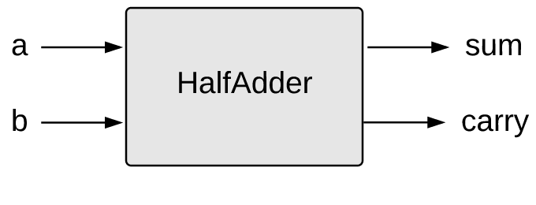
Half Adder
a | b | sum | carry
0 | 0 | 0 | 0
0 | 1 | 1 | 0
1 | 0 | 1 | 0
1 | 1 | 0 | 1
HalfAdder.hdl
/** Computes the sum of two bits. */
CHIP HalfAdder {
IN a, b;
OUT sum, carry;
PARTS:
// Put your code here:
}
Implementation tip
Can be built from two gates built in project 1.

Slide 88
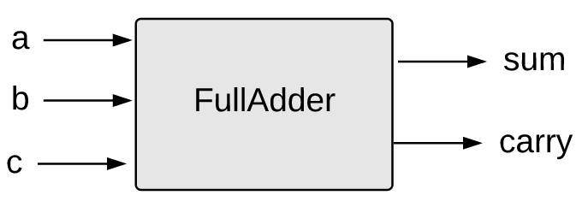
Full Adder
a | b | c | sum | carry
0 | 0 | 0 | 0 | 0
0 | 0 | 1 | 1 | 0
0 | 1 | 0 | 1 | 0
0 | 1 | 1 | 0 | 1
1 | 0 | 0 | 1 | 0
1 | 0 | 1 | 0 | 1
1 | 1 | 0 | 0 | 1
1 | 1 | 1 | 1 | 1
FullAdder.hdl
/** Computes the sum of three bits. */
CHIP FullAdder {
IN a, b, c;
OUT sum, carry;
PARTS:
// Put your code here:
}
Implementation tip
Can be built from two half-adders.

Slide 89
16-bit adder
Add16.hdl
/* Adds two 16-bit, two’s-complement values. The most-significant carry bit is ignored. */
CHIP Add16 {
IN a[16], b[16];
OUT out[16];
PARTS:
// Put you code here:
}
The bitwise additions are done in parallel
The carry propagation is sequential
Yet… it works fine, as is. How? Stay tuned for chapter 3.
Implementation note
If you need to set a pin x to 0 (or 1) in HDL, use: x = false (or x = true)

Slide 90
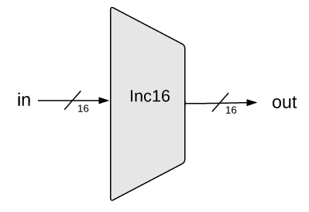
16-bit incrementor
Inc16.hdl
/** Outputs in + 1. */
CHIP Inc16 {
IN in[16];
OUT out[16];
PARTS:
// Put you code here:
}
Implementation:
Simple.

Slide 91
ALU

Slide 92
ALU
ALU.hdl
/** The ALU */

Slide 93
ALU
ALU.hdl
/** The ALU */
// Manipulates the x and y inputs as follows:
// if (zx == 1) sets x = 0 // 16-bit true
// if (nx == 1) sets x = !x // 16-bit Not
// if (zy == 1) sets y = 0 // 16-bit true
// if (ny == 1) sets y = !y // 16-bit Not
// if (f == 1) sets out = x + y // 2's-complement addition
// if (f == 0) sets out = x & y // 16-bit And
// if (no == 1) sets out = !out // 16-bit Not
// if (out == 0) sets zr = 1 // 1-bit true
// if (out < 0) sets ng = 1 // 1-bit true
...

Slide 94
ALU
Implementation tips
We need logic for:
Implementing “if bit == 0/1” conditions
Setting a 16-bit value to 0000000000000000
Setting a 16-bit value to 1111111111111111
Negating a 16-bit value (bitwise)
Computing Add and Or on two 16-bit values
ALU.hdl
/** The ALU */
// Manipulates the x and y inputs as follows:
// if (zx == 1) sets x = 0 // 16-bit true
// if (nx == 1) sets x = !x // 16-bit Not
// if (zy == 1) sets y = 0 // 16-bit true
// if (ny == 1) sets y = !y // 16-bit Not
// if (f == 1) sets out = x + y // 2's-complement addition
// if (f == 0) sets out = x & y // 16-bit And
// if (no == 1) sets out = !out // 16-bit Not
// if (out == 0) sets zr = 1 // 1-bit true
// if (out < 0) sets ng = 1 // 1-bit true
...
Implementation strategy
Start by building an ALU that computes out
Next, extend it to also compute zr and ng.

Slide 95
Relevant bus tips
Using multi-bit truth / false constants:
...
// Suppose that x, y, z are 8-bit bus-pins:
7
6
5
4
3
2
1
0
x:
y:
z:

Slide 96
Relevant bus tips
Using multi-bit truth / false constants:
...
// Suppose that x, y, z are 8-bit bus-pins:
chipPart(..., x = true, y = false, z[0..2] = true, z[6..7] = true);
...
7
6
5
4
3
2
1
0
x:
y:
z:

Slide 97
Relevant bus tips
Using multi-bit truth / false constants:
...
// Suppose that x, y, z are 8-bit bus-pins:
chipPart(..., x = true, y = false, z[0..2] = true, z[6..7] = true);
...
7
6
5
4
3
2
1
0
x:
1
1
1
1
1
1
1
1
y:
z:

Slide 98
Relevant bus tips
Using multi-bit truth / false constants:
...
// Suppose that x, y, z are 8-bit bus-pins:
chipPart(..., x = true, y = false, z[0..2] = true, z[6..7] = true);
...
7
6
5
4
3
2
1
0
x:
1
1
1
1
1
1
1
1
y:
0
0
0
0
0
0
0
0
z:

Slide 99
Relevant bus tips
Using multi-bit truth / false constants:
We can assign values to sub-buses
...
// Suppose that x, y, z are 8-bit bus-pins:
chipPart(..., x = true, y = false, z[0..2] = true, z[6..7] = true);
...
7
6
5
4
3
2
1
0
x:
1
1
1
1
1
1
1
1
y:
0
0
0
0
0
0
0
0
z:
1
1
0
0
0
1
1
1
Unassigned bits are set to 0

Slide 100
Relevant bus tips
Sub-bussing:
We can assign n-bit values to sub-buses, for any n
We can create n-bit bus pins, for any n
/* 16-bit adder */
CHIP Add16 {
IN a[16], b[16];
OUT out[16];
PARTS:
...
}
CHIP Foo {
IN x[8], y[8], z[16]
OUT out[16]
PARTS
...
Add16 (a[0..7] = x, a[8..15] = y, b = z, out = …);
...
Add16 (a = …, b = …, out[0..3] = t1, out[4..15] = t2);
...
}

Slide 101
Relevant bus tips
Sub-bussing:
We can assign n-bit values to sub-buses, for any n
We can create n-bit bus pins, for any n
/* 16-bit adder */
CHIP Add16 {
IN a[16], b[16];
OUT out[16];
PARTS:
...
}
CHIP Foo {
IN x[8], y[8], z[16]
OUT out[16]
PARTS
...
Add16 (a[0..7] = x, a[8..15] = y, b = z, out = …);
...
Add16 (a = …, b = …, out[0..3] = t1, out[4..15] = t2);
...
}
Another example of assigning a multi-bit value to a sub-bus

Slide 102
Relevant bus tips
Sub-bussing:
We can assign n-bit values to sub-buses, for any n
We can create n-bit bus pins, for any n
/* 16-bit adder */
CHIP Add16 {
IN a[16], b[16];
OUT out[16];
PARTS:
...
}
CHIP Foo {
IN x[8], y[8], z[16]
OUT out[16]
PARTS
...
Add16 (a[0..7] = x, a[8..15] = y, b = z, out = …);
...
Add16 (a = …, b = …, out[0..3] = t1, out[4..15] = t2);
...
}
Another example of assigning a multi-bit value to a sub-bus
Creating an n-bit bus (internal pin)

Slide 103
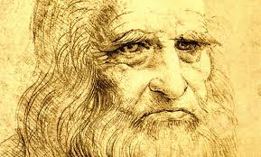
ALU: Recap
The Hack ALU is:
Simple
Elegant
“Simplicity is the ultimate sophistication.”
― Leonardo da Vinci

Slide 104
Chapter 2: Boolean Arithmetic
Theory
Representing numbers
Binary numbers
Boolean arithmetic
Signed numbers
Practice
Arithmetic Logic Unit (ALU)
Project 2: Chips
Project 2: Guidelines

Slide 105
Project 2
Given: All the chips built in Project 1
Goal: Build the chips:
HalfAdder
FullAdder
Add16
Inc16
ALU

Slide 106
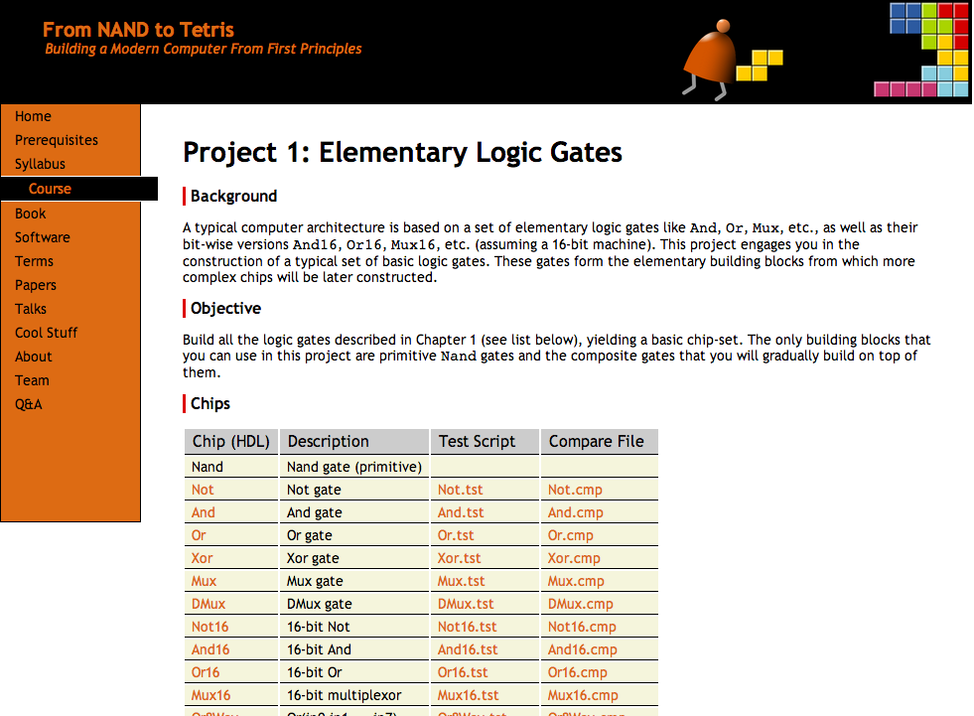
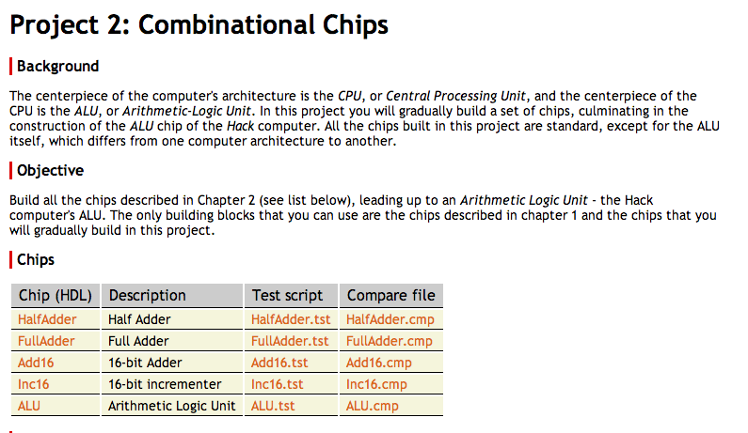
Guidelines: www.nand2tetris.org/project02
www.nand2tetris.org

Slide 107
Resources
Project 2 folder (.hdl, .tst, .cmp files): nand2tetris/projects/02
Tools
Text editor (for completing the given .hdl stub-files)
Hardware simulator: nand2tetris/tools
Guides
Hardware Simulator Tutorial
HDL Guide
Hack Chip Set API

Slide 108
Chip interfaces: Hack chip set API
Open the API in a window, and copy-paste chip signatures into your HDL code, as needed
Add16 (a= ,b= ,out= );
ALU (x= ,y= ,zx= ,nx= ,zy= ,ny= ,f= ,no= ,out= ,zr= ,ng= );
And16 (a= ,b= ,out= );
And (a= ,b= ,out= );
Aregister (in= ,load= ,out= );
Bit (in= ,load= ,out= );
CPU (inM= ,instruction= ,reset= ,outM= ,writeM= ,addressM= ,pc= );
DFF (in= ,out= );
DMux4Way (in= ,sel= ,a= ,b= ,c= ,d= );
DMux8Way (in= ,sel= ,a= ,b= ,c= ,d= ,e= ,f= ,g= ,h= );
Dmux (in= ,sel= ,a= ,b= );
Dregister (in= ,load= ,out= );
FullAdder (a= ,b= ,c= ,sum= ,carry= );
HalfAdder (a= ,b= ,sum= , carry= );
Inc16 (in= ,out= );
Keyboard (out= );
Memory (in= ,load= ,address= ,out= );
Mux16 (a= ,b= ,sel= ,out= );
Mux4Way16 (a= ,b= ,c= ,d= ,sel= ,out= );
Mux8Way16 (a= ,b= ,c= ,d= ,e= ,f= ,g= ,h= ,sel= ,out= );
Mux8Way (a= ,b= ,c= ,d= ,e= ,f= ,g= ,h= ,sel= ,out= );
Mux (a= ,b= ,sel= ,out= );
Nand (a= ,b= ,out= );
Not16 (in= ,out= );
Not (in= ,out= );
Or16 (a= ,b= ,out= );
Or8Way (in= ,out= );
Or (a= ,b= ,out= );
PC (in= ,load= ,inc= ,reset= ,out= );
PCLoadLogic (cinstr= ,j1= ,j2= ,j3= ,load= ,inc= );
RAM16K (in= ,load= ,address= ,out= );
RAM4K (in= ,load= ,address= ,out= );
RAM512 (in= ,load= ,address= ,out= );
RAM64 (in= ,load= ,address= ,out= );
RAM8 (in= ,load= ,address= ,out= );
Register (in= ,load= ,out= );
ROM32K (address= ,out= );
Screen (in= ,load= ,address= ,out= );
Xor (a= ,b= ,out= );

Slide 109
Best practice advice (same as project 1)
Implement the chips in the order in which they appear in the project guidelines
If you don’t implement some chips, you can still use their built-in implementations
No need for “helper chips”: Implement / use only the chips we specified
In each chip definition, strive to use as few chip-parts as possible

Slide 110
Best practice advice
Implement the chips in the order in which they appear in the project guidelines
If you don’t implement some chips, you can still use their built-in implementations
No need for “helper chips”: Implement / use only the chips we specified
In each chip definition, strive to use as few chip-parts as possible
You will have to use chips implemented in Project 1;
For efficiency and consistency’s sake, use their built-in versions, rather than your own HDL implementations.
That’s It!
Go Do Project 2!

Slide 111
Chapter 2: Boolean Arithmetic
Theory
Representing numbers
Binary numbers
Boolean arithmetic
Representing signed numbers
Practice
Arithmetic Logic Unit (ALU)
Project 2: Chips
Project 2: Guidelines

Slide 112
What’s next?
abstraction
machine language
This lecture / chapter / project:
Build the computer’s ALU
assembler
p6
hardware platform
abstraction
Building a computer
computer
abstraction
Building chips
p4
ALU, RAM
abstraction
Building gates
p5
p2
elementary logic gates
Nand
p3
p1

Slide 113
What’s next?
abstraction
machine language
This lecture / chapter / project:
Build the computer’s ALU
assembler
p6
hardware platform
abstraction
Building a computer
computer
abstraction
Building chips
p4
ALU, RAM
abstraction
Building gates
p5
p2
elementary logic gates
Nand
p3
p1
Next lecture / chapter / project:
Build the computer’s RAM

